Slide 1
Best Practices & Implementation
Session 4
Shailendra Kumar Saini, Taru Sharma

Slide 2
Objective
Modularizing
Procedures
Functions
Performance - Indexing
Indexing
Indexing Methods
Manage Indexing
Query Optimization techniques
Analyzing database queries
Query Optimization

Slide 3
Modularizing
Modularization is the process by which you break up large blocks of code into smaller pieces -- modules -- which can be called by other modules.
Modularization of code is analogous to normalization of data, with many of the same benefits and a few additional advantages. With modularization, your code becomes:
Reusable.
Manageable
Readable
Reliable.

Slide 4
Procedures
What is a Stored Procedure?
A stored procedure is a prepared SQL code that you can save, so the code can be reused over and over again.
So if you have an SQL query that you write over and over again, save it as a stored procedure, and then just call it to execute it.
You can also pass parameters to a stored procedure, so that the stored procedure can act based on the parameter value(s) that is passed.

Slide 5
Procedures
The following MySQL statements demonstrate how to create a very basic stored procedure named procedureTest.
CREATE PROCEDURE procedureTest() BEGIN SELECT prod_name FROM products; END$$
To invoke the stored procedure, use the following MySQL statement:
CALL procedureTest()
https://dev.mysql.com/doc/refman/8.0/en/create-procedure.html

Slide 6
Functions
A function is a special kind stored program that returns a single value. You use stored functions to encapsulate common formulas or business rules that are reusable among SQL statements or stored programs.
Different from a stored procedure, you can use a stored function in SQL statements wherever an expression is used. This helps improve the readability and maintainability of the procedural code.

Slide 7
Functions
MySQL stored/User Defined function syntax
The following illustrates the simplest syntax for creating a new stored function:
CREATE FUNCTION function_name(param1,param2,…)
RETURNS datatype
[NOT] DETERMINISTIC
statements
http://www.mysqltutorial.org/mysql-stored-function/

Slide 8
Procedures vs Functions
Difference between Procedures and Functions
Function must return a value but in Stored Procedure it is optional( Procedure can return zero or n values).
Functions can have only input parameters for it whereas Procedures can have input/output parameters .
Functions can be called from Procedure whereas Procedures cannot be called from Function.
Procedure allows SELECT as well as DML(INSERT/UPDATE/DELETE) statement in it whereas Function allows only SELECT statement in it.
Stored Procedures cannot be used in the SQL statements anywhere in the WHERE/HAVING/SELECT section whereas Function can be.
https://www.geeksforgeeks.org/difference-between-function-and-procedure/

Slide 9
Performance - Indexing
Indexing is a way to optimize performance of a database by minimizing the number of disk accesses required when a query is processed.
An index or database index is a data structure which is used to quickly locate and access the data in a database table.
Indexes are created using some database columns.
The first column is the Search key that contains a copy of the primary key or candidate key of the table. These values are stored in sorted order so that the corresponding data can be accessed quickly (Note that the data may or may not be stored in sorted order).
The second column is the Data Reference which contains a set of pointers holding the address of the disk block where that particular key value can be found.

Slide 10
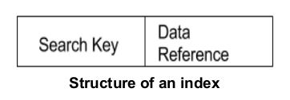
Indexing
There are two kinds of indices:
Ordered indices: Indices are based on a sorted ordering of the values.
Hash indices: Indices are based on the values being distributed uniformly across a range of buckets. The buckets to which a value is assigned is determined by function called a hash function.
https://www.javatpoint.com/indexing-in-dbms

Slide 11
Indexing
There is no comparison between both the techniques, it depends on the database application on which it is being applied.
Access Types: e.g. value based search, range access, etc.
Access Time: Time to find particular data element or set of elements.
Insertion Time: Time taken to find the appropriate space and insert a new data time.
Deletion Time: Time taken to find an item and delete it as well as update the index structure.
Space Overhead: Additional space required by the index.

Slide 12
Indexing Methods
Clustered Indexing
Clustered indexes sort and store the data rows in the table or view based on their key values. These are the columns included in the index definition. There can be only one clustered index per table, because the data rows themselves can be stored in only one order.
The only time the data rows in a table are stored in sorted order is when the table contains a clustered index. When a table has a clustered index, the table is called a clustered table.

Slide 13

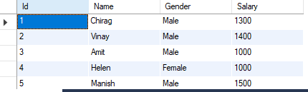
Indexing Methods
​
Clustered index sorted according to Id (Search key)

Slide 14
Indexing Methods
Non­-Clustered Indexing
​A non clustered index just tells us where the data lies, i.e. it gives us a list of virtual pointers or references to the location where the data is actually stored. Data is not physically stored in the order of the index. Instead , data is present in leaf nodes. For eg. the contents page of a book. Each entry gives us the page number or location of the information stored. The actual data here(information on each page of book) is not organised but we have an ordered reference(contents page) to where the data points actually lie.
It requires more time as compared to clustered index because some amount of extra work is done in order to extract the data by further following the pointer. In case of clustered index, data is directly present in front of the index.

Slide 15
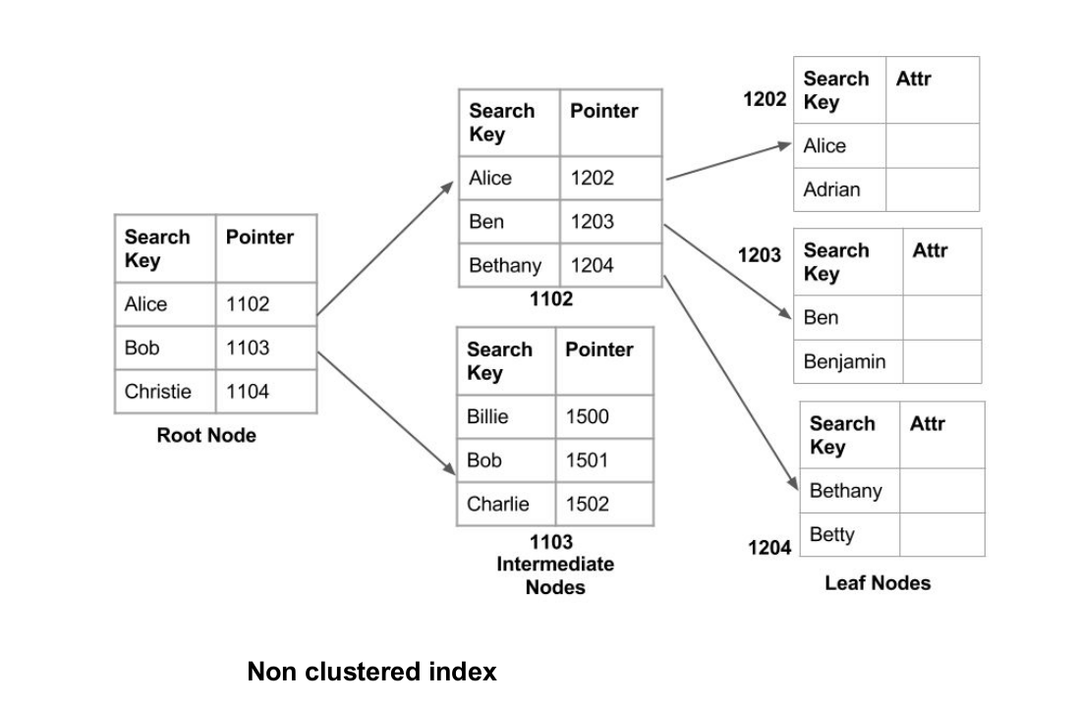
Indexing Methods
BEGIN TRANSACTION
INSERT authors VALUES (etc.)
SELECT * FROM authors
UPDATE publishers SET pub_id = (etc.)
COMMIT TRANSACTION

Slide 16
Manage Indexing
To add an index to a table, type the following SQL command. Replace table_namewith the name of the table, index_name with the name of the new index (which can be anything you want), and table_column with the name of the table column for which you want to add the index:
ALTER TABLE table_name ADD INDEX index_name (table_column);
Although indexes can improve performance, indexes can also negatively impact performance if there are too many of them. This is because the more indexes a table has, the more work MySQL must do to keep them updated. The trick is to find the right balance between enough indexes to improve performance, but not so many that they negatively impact performance.

Slide 17
Manage Indexing
To remove an index from a table, type the following SQL command. Replace table_name with the name of the table, and replace index_name with the name of the index that you want to delete:
ALTER TABLE table_name DROP INDEX index_name;
To view all of the indexes for a table, type the following SQL command. Replace table_name with the name of the table:
SHOW INDEX FROM table_name \G

Slide 18
Analyzing database queries
To determine which tables may benefit from using indexes, you must analyze your database queries. The EXPLAIN SELECT statement helps you do this. To analyze database queries, follow these steps:
Type the following SQL command:
EXPLAIN SELECT * FROM table_name WHERE conditions \G
Output from the EXPLAIN SELECT statement shows how the MySQL query optimizer will execute the query. For example, consider the following output:

Slide 19
Analyzing database queries
mysql> EXPLAIN SELECT title FROM employees WHERE lastname LIKE 'T%' \G *************************** 1. row *************************** id: 1 select_type: SIMPLE table: employees type: ALL possible_keys: NULL key: NULL key_len: NULL ref: NULL rows: 142 Extra: Using where 1 row in set (0.00 sec)

Slide 20
Analyzing database queries
In this example output:
The possible_keys and key values are both NULL, which indicates that MySQL does not have an index it can use for this query.
The rows value indicates that MySQL will read 142 rows for this query. If there are 142 total rows in the table, this means MySQL must examine every row to generate the result set. This could take quite some time for a large table.
On the other hand, if we were to create an index called index_name for the lastname column, MySQL might generate the following output for the same query.

Slide 21
Analyzing database queries
mysql> EXPLAIN SELECT title FROM employees WHERE lastname LIKE 'T%' \G *************************** 1. row *************************** id: 1 select_type: SIMPLE table: employees type: range possible_keys: index_name key: index_name key_len: 22 ref: NULL rows: 17 Extra: Using where; Using index 1 row in set (0.00 sec)

Slide 22
Analyzing database queries
As you can see, the possible_keys and key values indicate that MySQL has found an index it can use to optimize the query.
Additionally, MySQL will read only 17 rows to generate the result set, instead of all 142 rows. (This means the table has 17 rows where the last name begins with “T”.) Lastly, the Extra value also indicates that MySQL will use an index for the query.
https://www.a2hosting.in/kb/developer-corner/mysql/using-indexes-to-improve-mysql-query-performance

Slide 23
Analyzing database queries
After you create an index, you should use the EXPLAIN SELECT statement again to see how queries are affected. Additionally, you should continue to monitor database performance to see if there are improvements. You may have to run a series of tests to find the optimal number of indexes for your database.

Slide 24
Query Optimization
Query: A query is a request for information from a database.
Query Plans: A query plan (or query execution plan) is an ordered set of steps used to access data in a SQL relational database management system.
Query Optimization: A single query can be executed through different algorithms or re-written in different forms and structures. Hence, the question of query optimization comes into the picture – Which of these forms or pathways is the most optimal?
Importance: The goal of query optimization is to reduce the system resources required to fulfill a query, and ultimately provide the user with the correct result set faster.
https://www.geeksforgeeks.org/query-optimization/

Slide 25
Tips for Query Optimization
Move sql code from application to Database server.
Removes duplicate code.
Reusability
Proper analysis with several database tools.
Improving performance by using various advanced indexing techniques.
Do not use Select *
Use exists instead of count(*) for existence check.
Avoid joining on different data type.
Avoid dynamic sql: Hard to debug and troubleshoot, possibility of sql injection attacks.
User table variables instead of temporary tables.
Preference to Full text search instead of LIKE.

Slide 26
Tips for Query Optimization
Union All -> Union -> OR (least preference)
Store large data in separate table having reference in primary table.
Varchar(Max), NVarchar(Max) over Text, NText
Do not use SP name as SP_XXX…
Set No Count On
Avoid triggers.
User views for reusing complex sql.
Avoid views that have only one table.
Avoid nested transactions.
Start a transaction as late as possible and commit/rollback as soon as possible.

Slide 27
Summary
Stored Procedure
User Defined Function
Query Optimization and Analyzing
Indexing, uses, method and type

Slide 28
References
http://beginner-sql-tutorial.com/sql-query-tuning.htm
https://www.geeksforgeeks.org/query-optimization/
http://nptel.ac.in/courses/106104021/
https://youtu.be/GYQZpYEaNvk

